Slide 1
DEFAULT PAYMENT CLASSIFICATION
Done by: Goh Rui Zhuo (2222329)

Slide 2
OBJECTIVES
(HOW IS YOUR PREDICTION TASK DEFINED? AND WHAT IS THE MEANING OF THE OUTPUT VARIABLE?)
Prediction task is defined as to predict which customer will have default payment in the next month.
Output variable: Default payment next month

Slide 3
What is Inside the dataset ?
Dataset contains:
`Customer ID`: Unique customer identifier ranging from 1 to 1600
`Credit Limit`: The credit limit for the customer
`Gender`: Customer gender
`Education`: Customer education level
`Marriage Status`: Customer marital status
`Age`: Rotational Customer age
`Bill_Amount1`: Customer credit card bill amount 1 month ag
`Bill_Amount2`: Customer credit card bill amount 2 month ag
- `Bill_Amount3`: Customer credit card bill amount 3 month ago
`Pay_Amount1`: The amount customer paid 1 month ago
`Pay_Amount2`: The amount customer paid 2 month ago
`Pay_Amount3`: The amount customer paid 3 month ago
`Default payment next month`: Whether customer will default next month, 1 means default (customer will not pay the bill), 0 means non default (customer will pay the bill)

Slide 4
01
EXPLORATORY DATA ANALYSIS
Here we will analysis this dataset

Slide 5
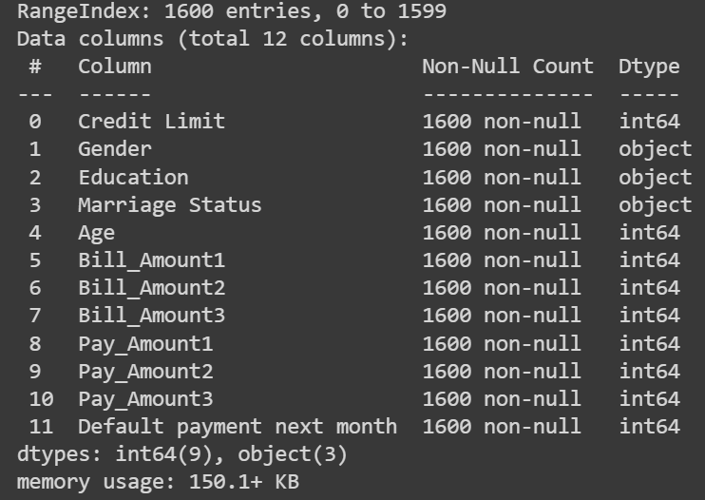
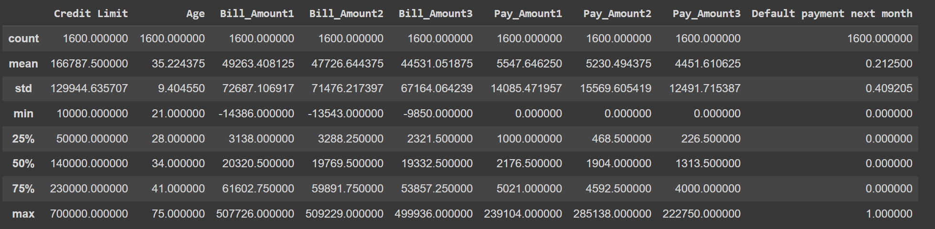
General Ino
No anomaly dtype in the dataset
However, anomaly was observed where bill amount less than $0

Slide 6
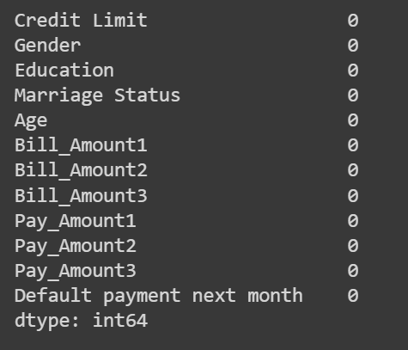
General Ino
Dataset is clean with no missing values and therefore additional exploratory data analysis can be done

Slide 7
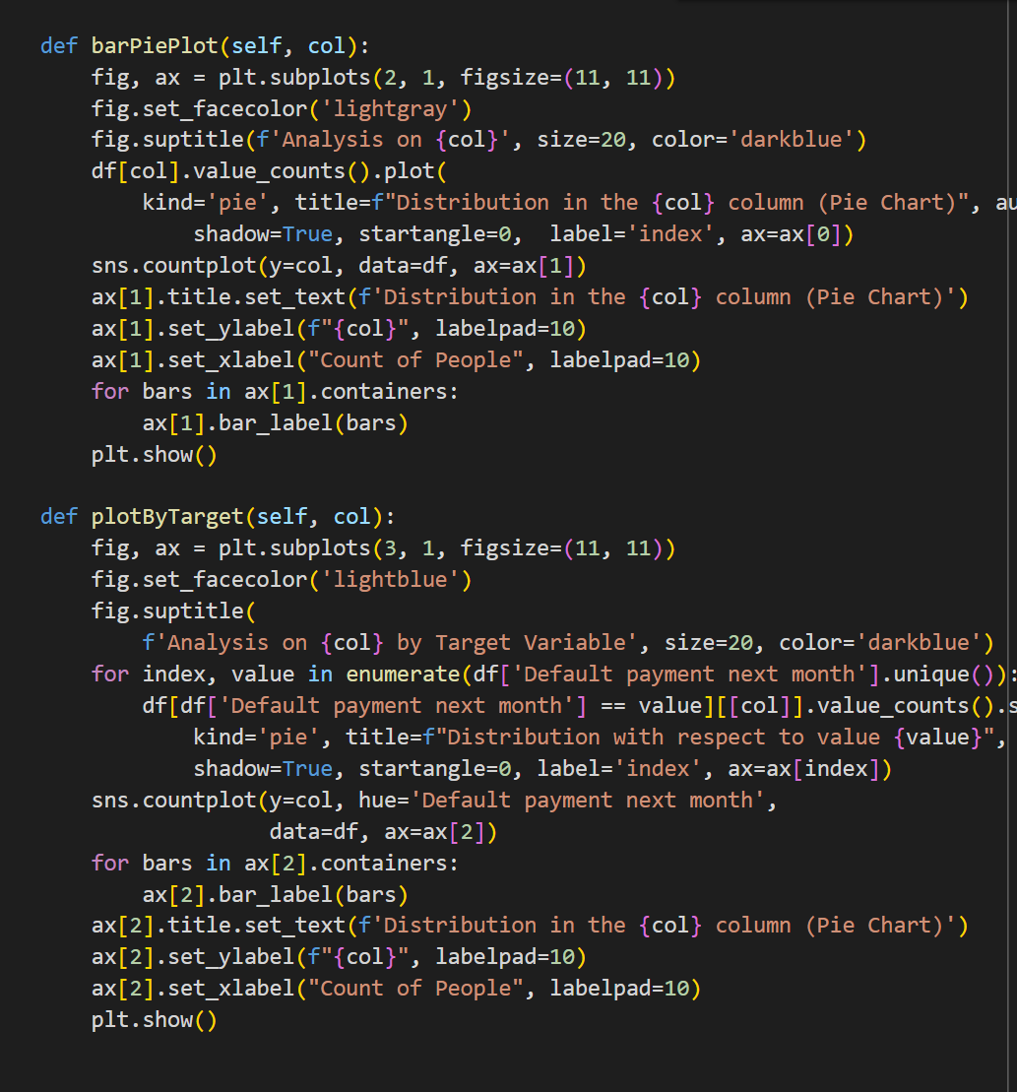
Analysis on categorical data
Function for analysing categorical data

Slide 8
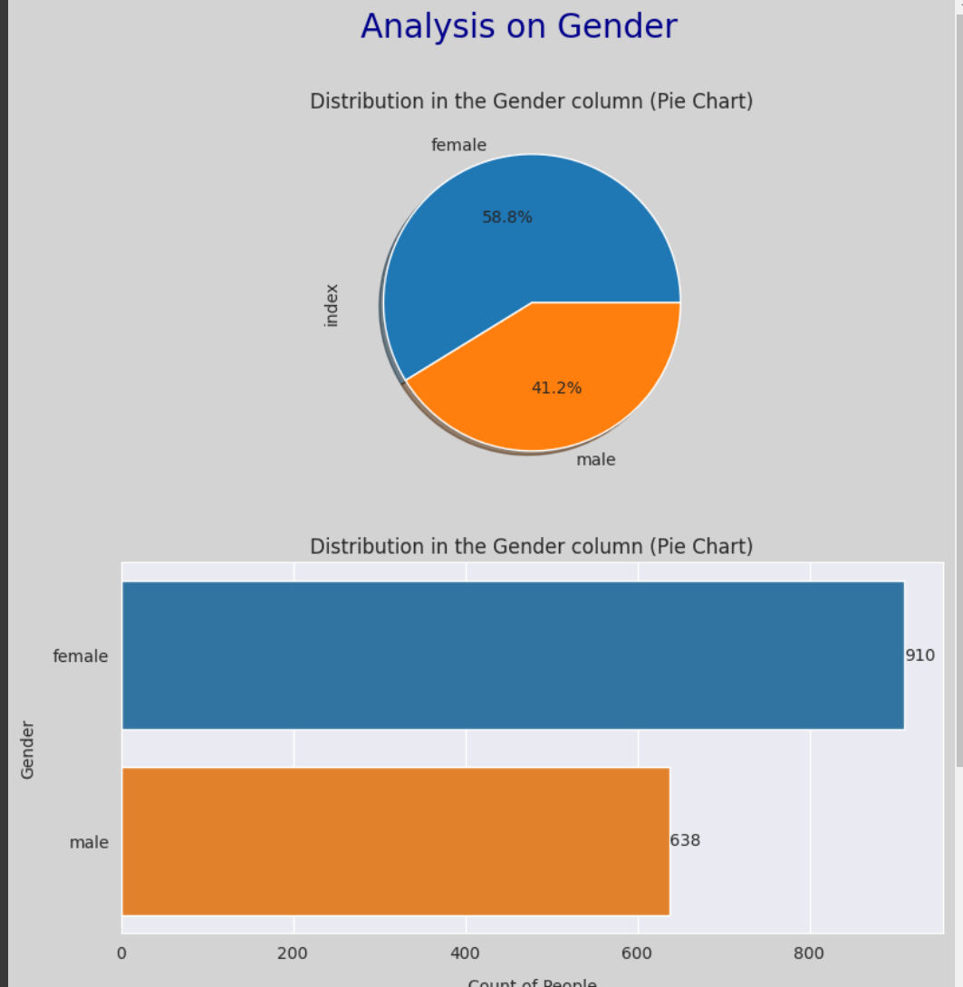
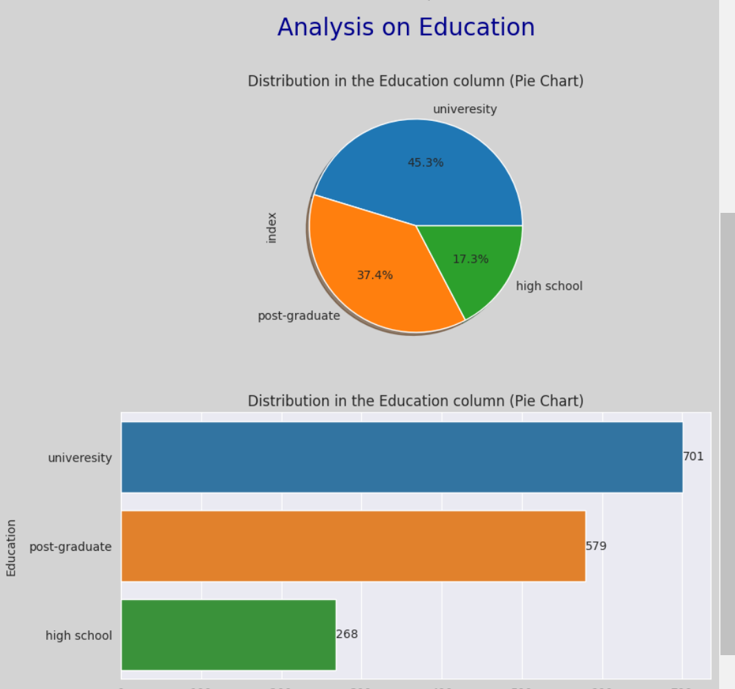
Analysis on categorical data (Education and gender)
First graph: Slightly higher proportion of female as compared to male at 41.2% as compared to 58.7%.
In addition, the countplot shows that female has over 800 rows while male contains more than 600 rows
Second plot: Higher proportion of university datas, at 37.7%
From the countplot, we can see that University data has over 700 rows in total

Slide 9
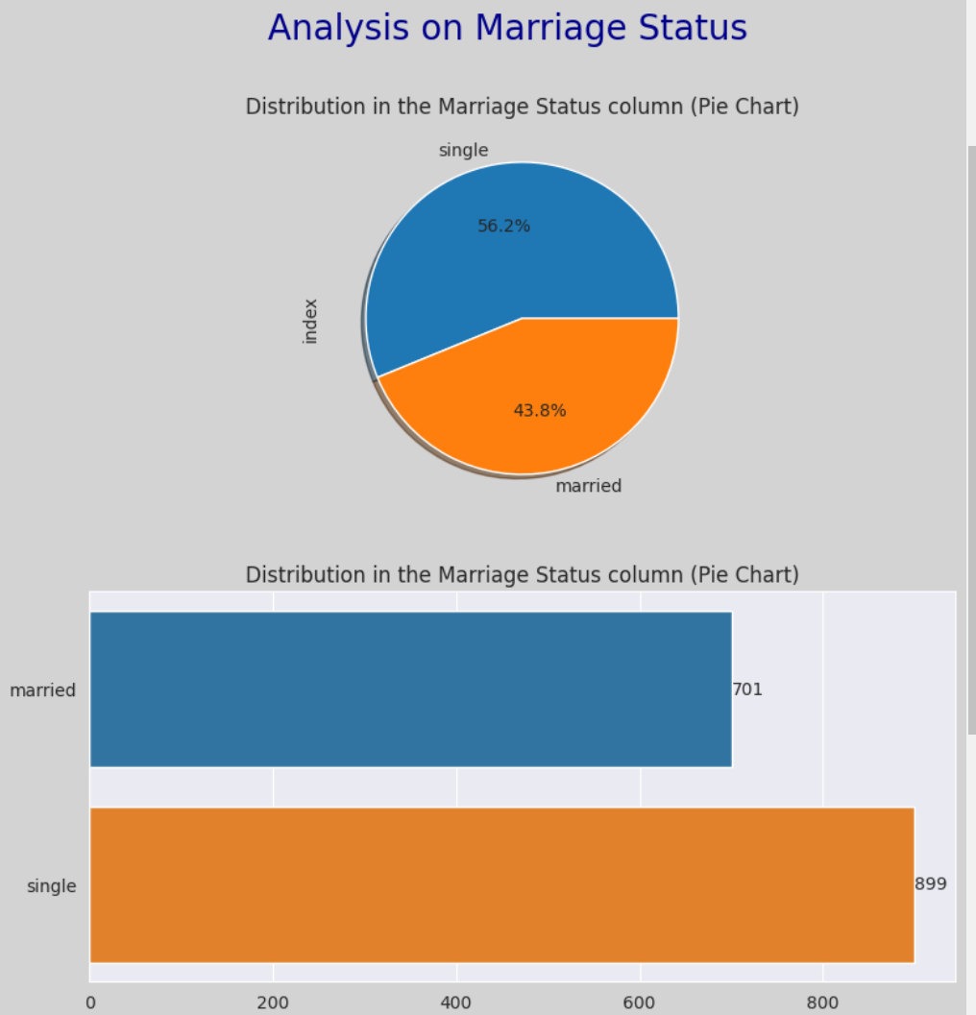
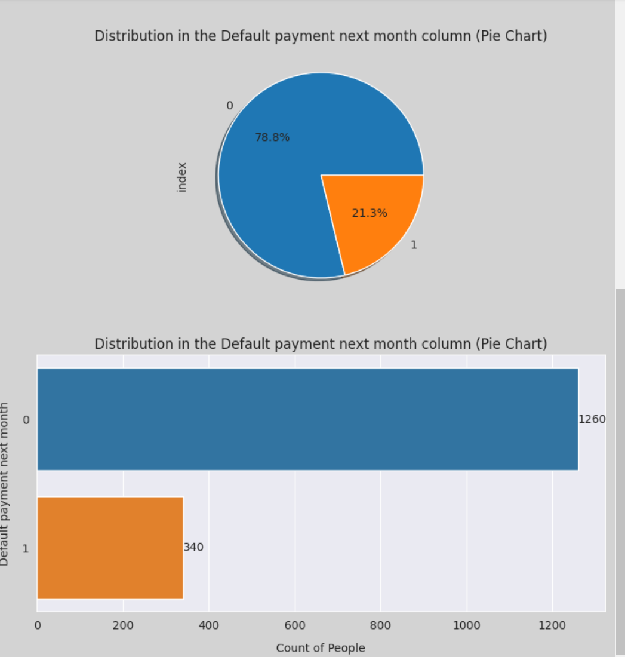
Analysis on categorical data (Education and gender)
Third graph: Higher proportion of people are single at 56.2% and married at 43.8%.
From the countplot, we can see that single contains over 800 rows
Fourth graph: Imbalance of class where the output 0 occurs more than 78.8% of the time
From the countplot, this amounts to more than 1200 of class 0

Slide 10
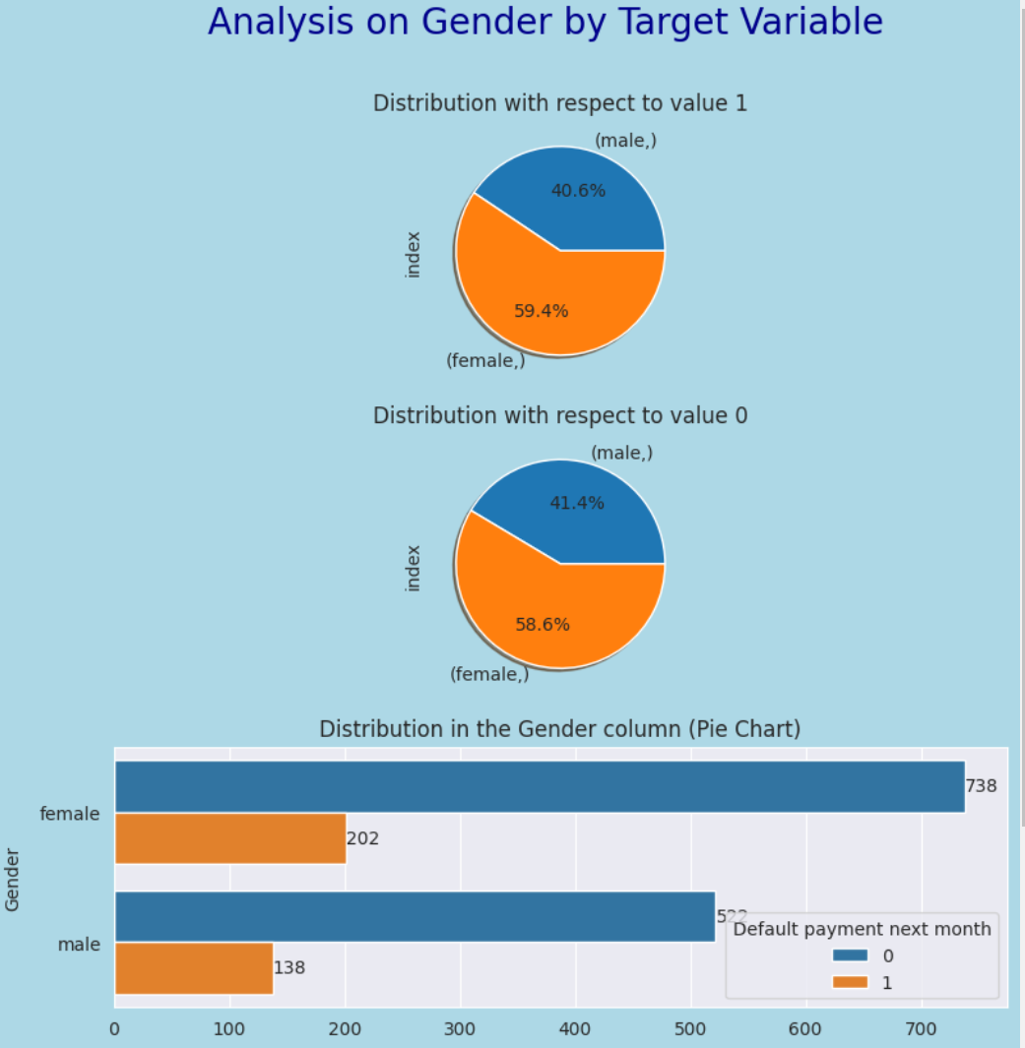
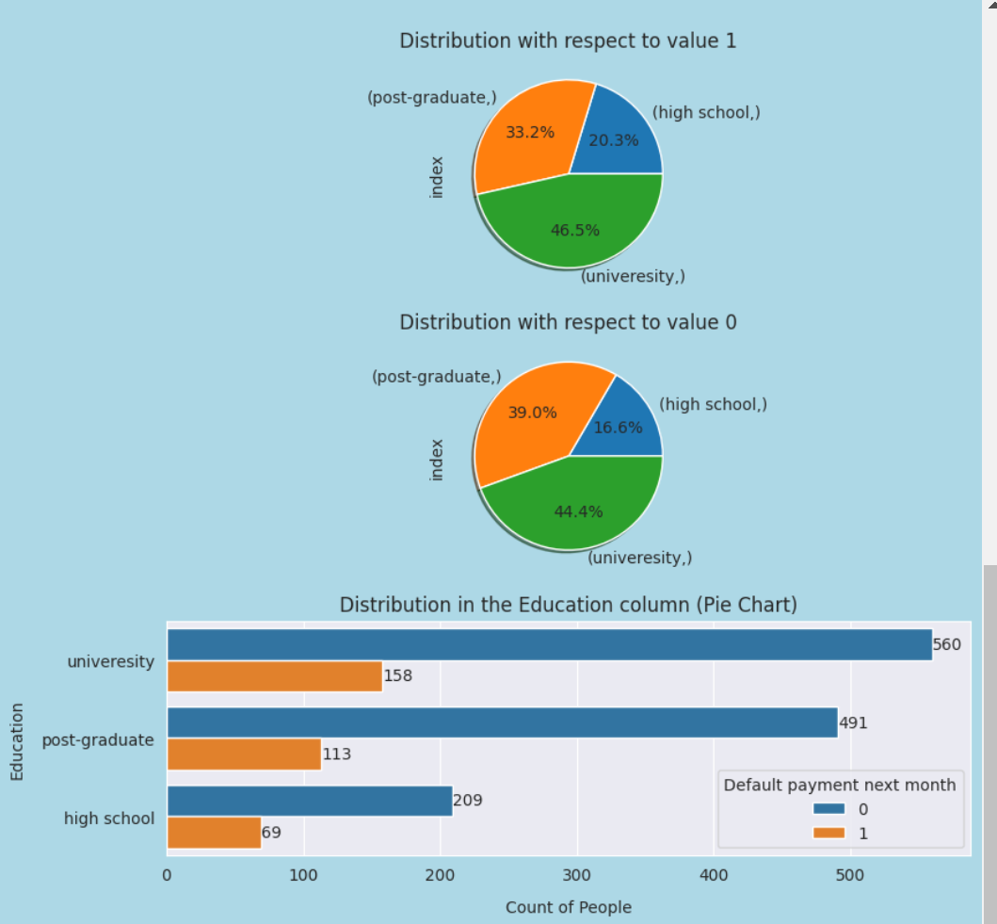
Analysis on categorical data with respect to target
First graph of gender to default payment: female has a higher percentage of 59.4% with male at 40.6%
From the countplot, lower amount of total amount of people with default payment 1
Second graph: university students has the highest percentage of people having classify as default payment 1 but this could be because university has the highest respondents in the dataset

Slide 11
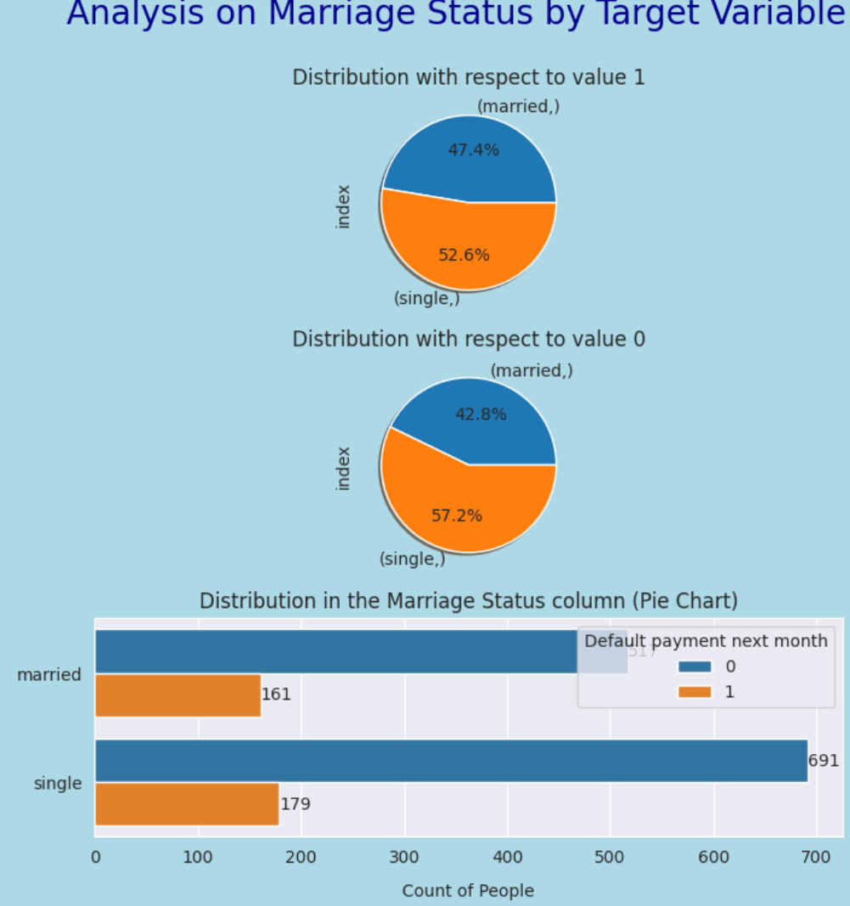
Analysis on categorical data with respect to target
Third graph: Single has a higher percentage of people having default payment 1 similarly for default payment 0 but this could be due to higher respondents

Slide 12
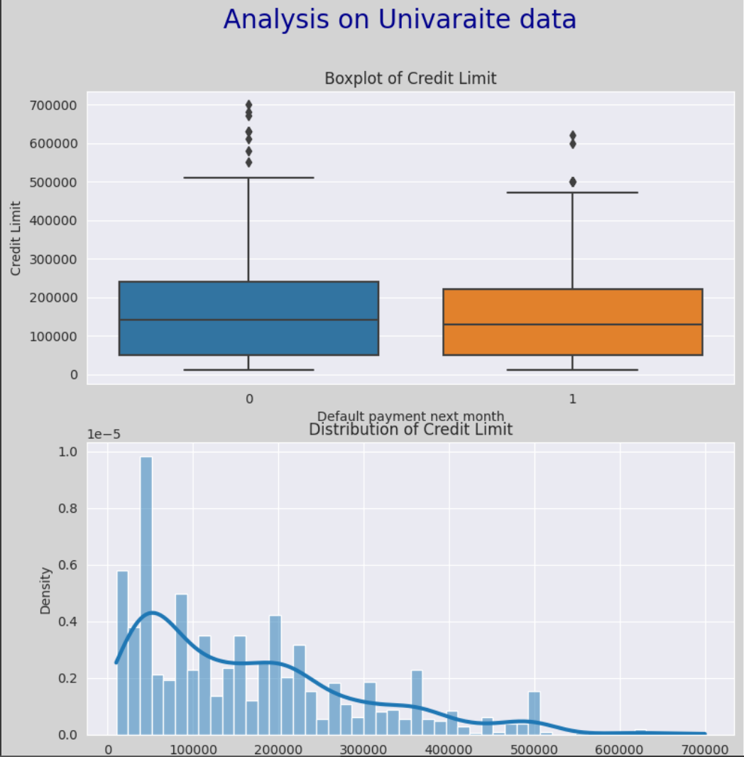
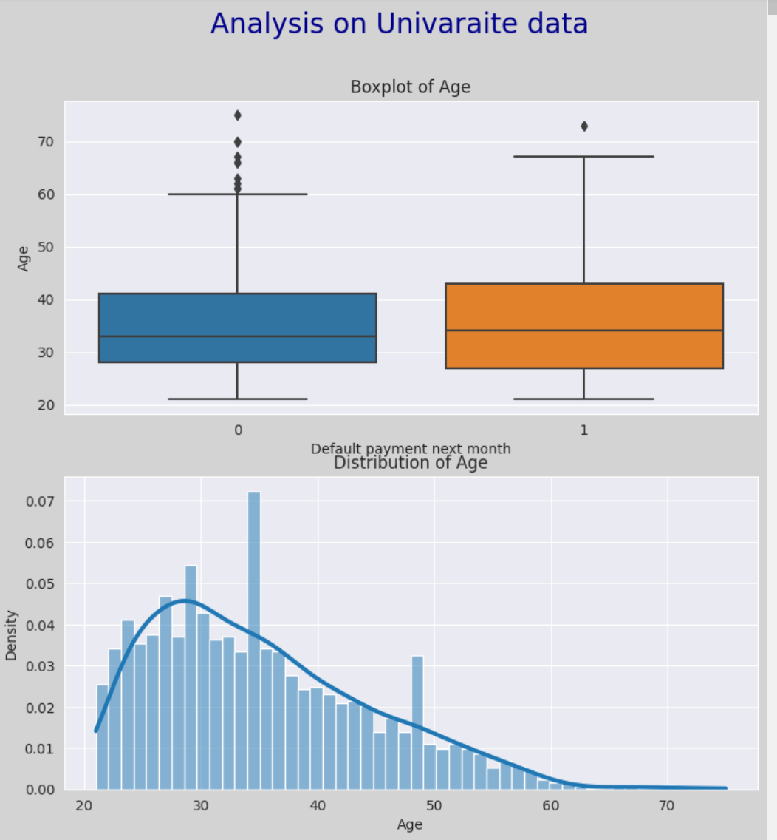
Analysis on numerical data
First plot on credit limit: Those have default payment of 0 have a larger range and interquartile range as compared to those who have a default payment of 1
From the histogram, it is positively skewed, with majority between the 10000 to 20000 range
Second plot on Age,: those who have default payment of 0 have a smaller range and interquartile range as compared to those who have a default payment of 1
From the histogram, Age is positively skewed with majority less than the age of 40

Slide 13
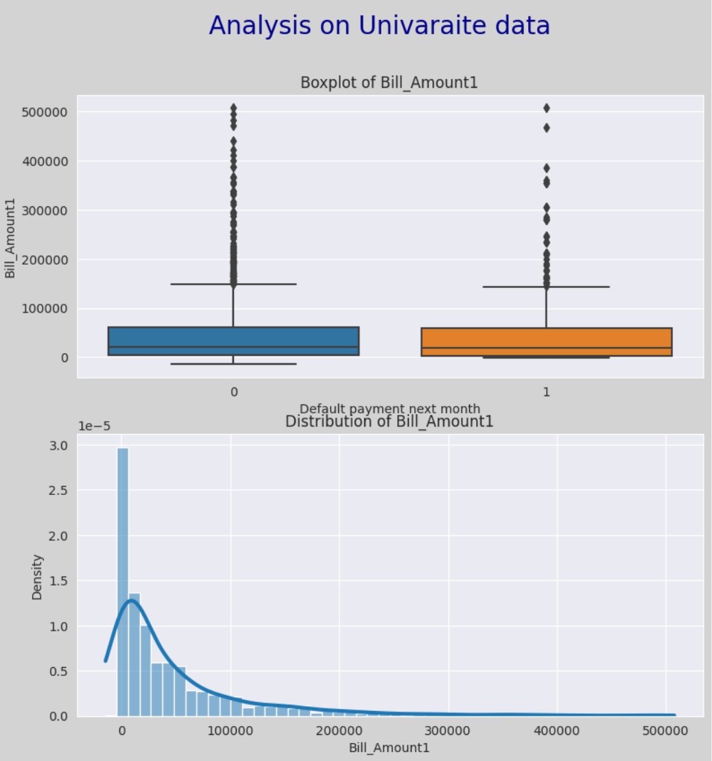
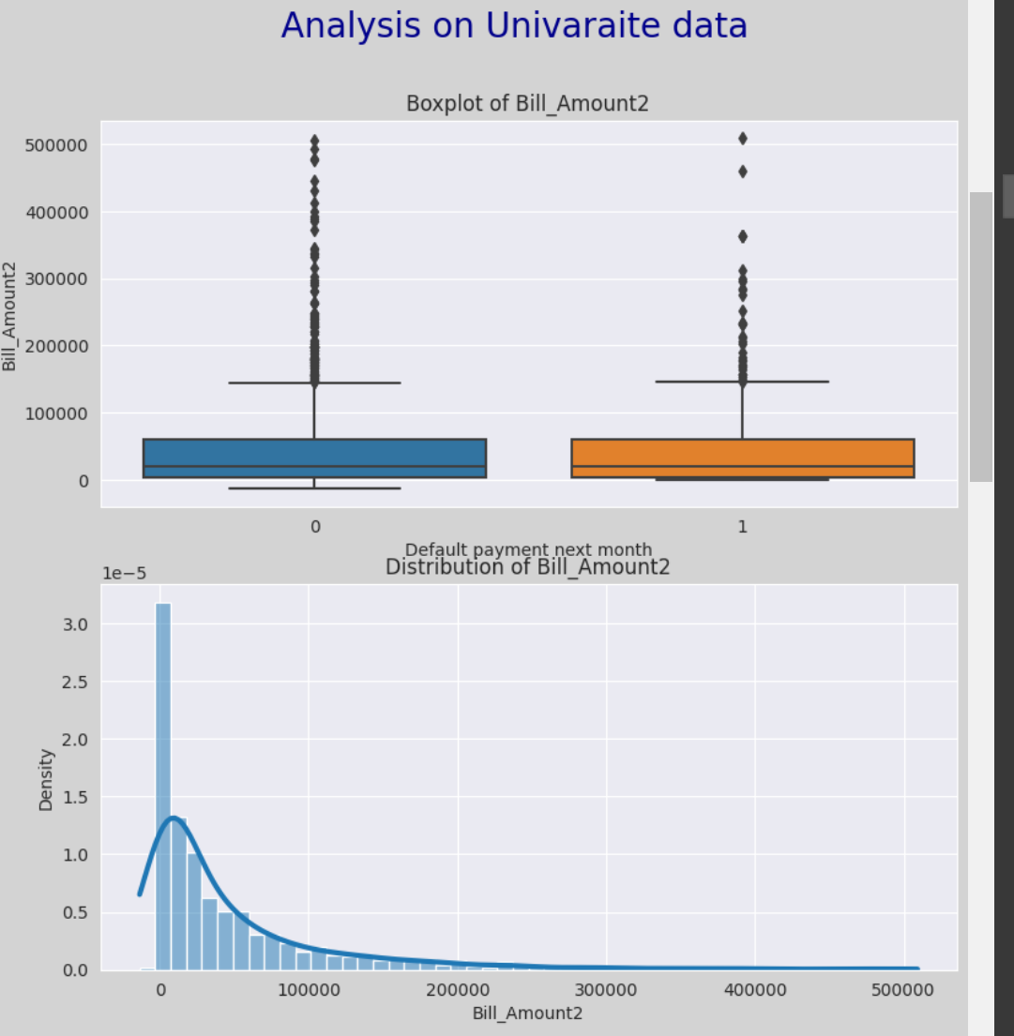
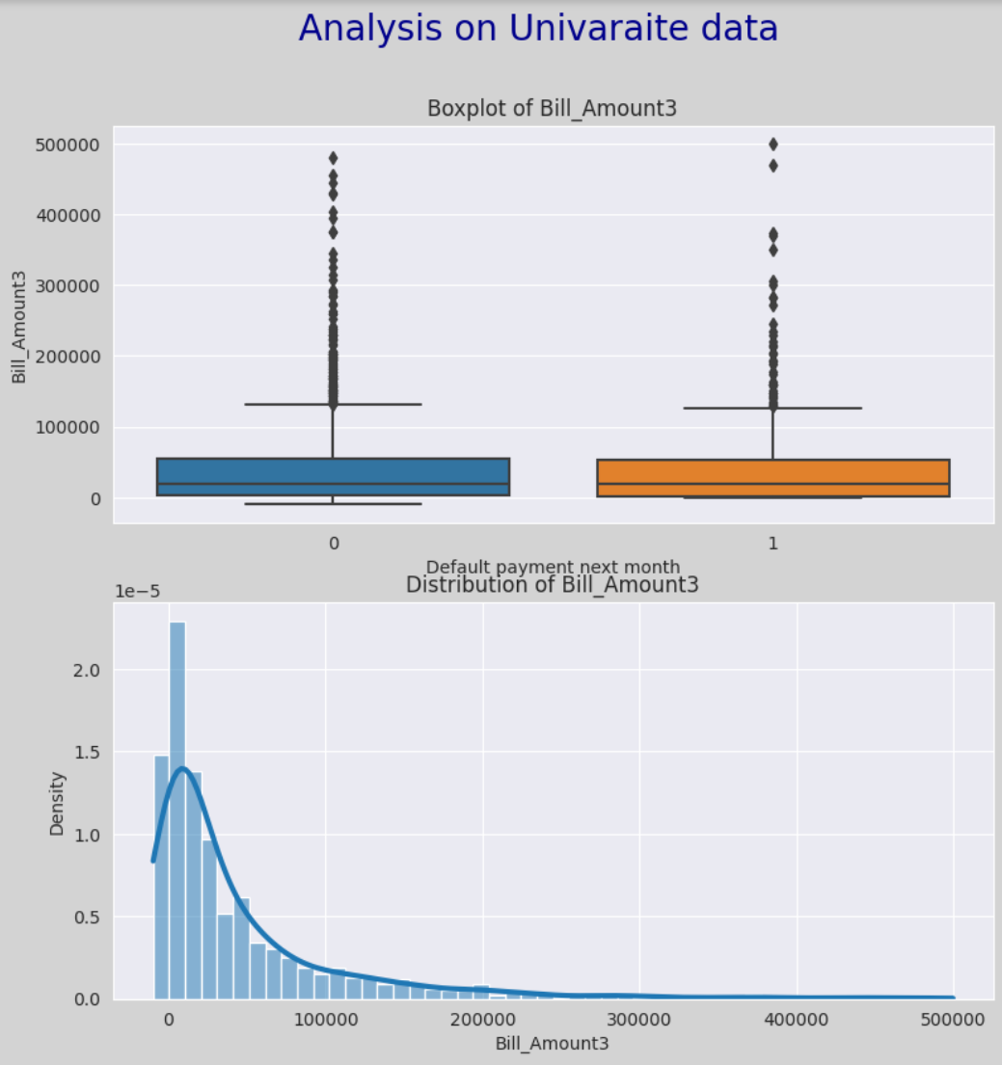
Analysis on numerical data
Plots on Bill Amount 1 to 3 month ago: Those who have default payment of 0 have a wider range and interquartile range as compared to those who have a default payment of 1. Both contains numerous outliers
From the histograms, Bill Amount 1 to 3 is positively skewed with majority less than 10000
Also, there are negative values in bill amounts

Slide 14
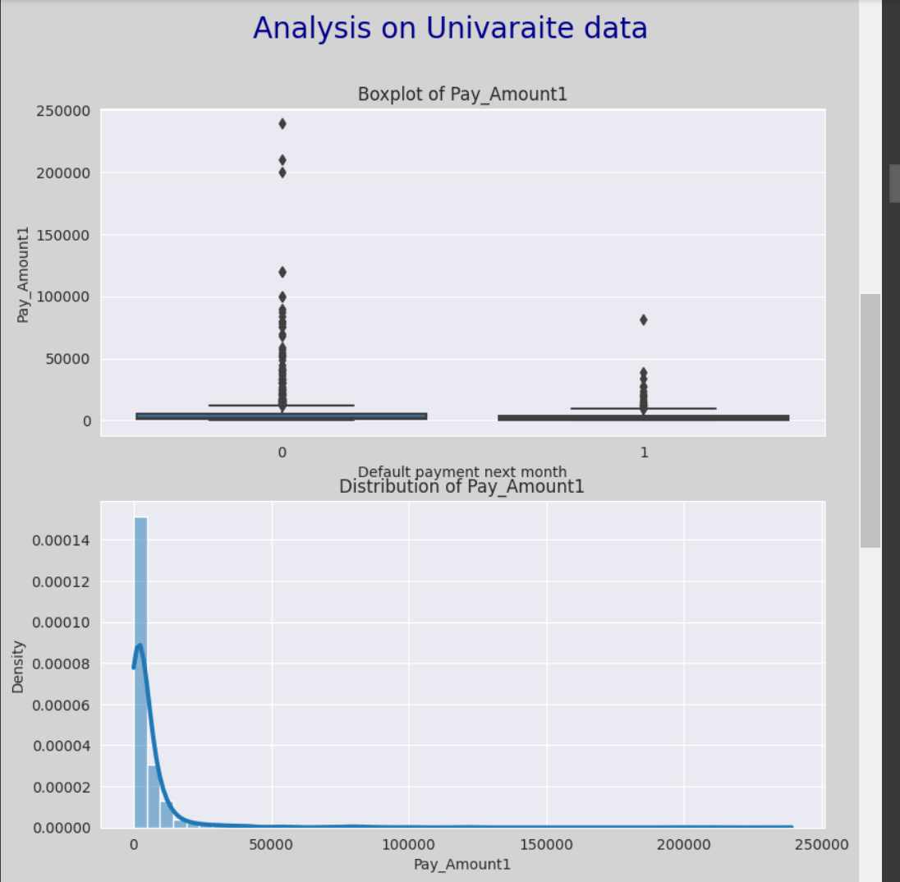
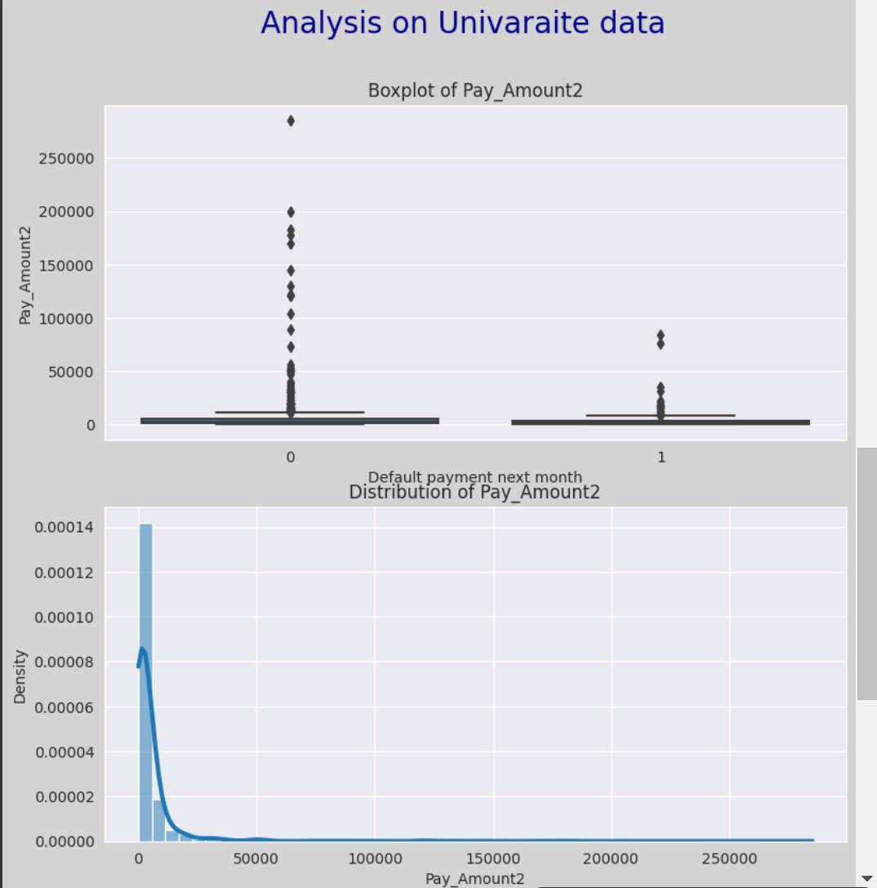
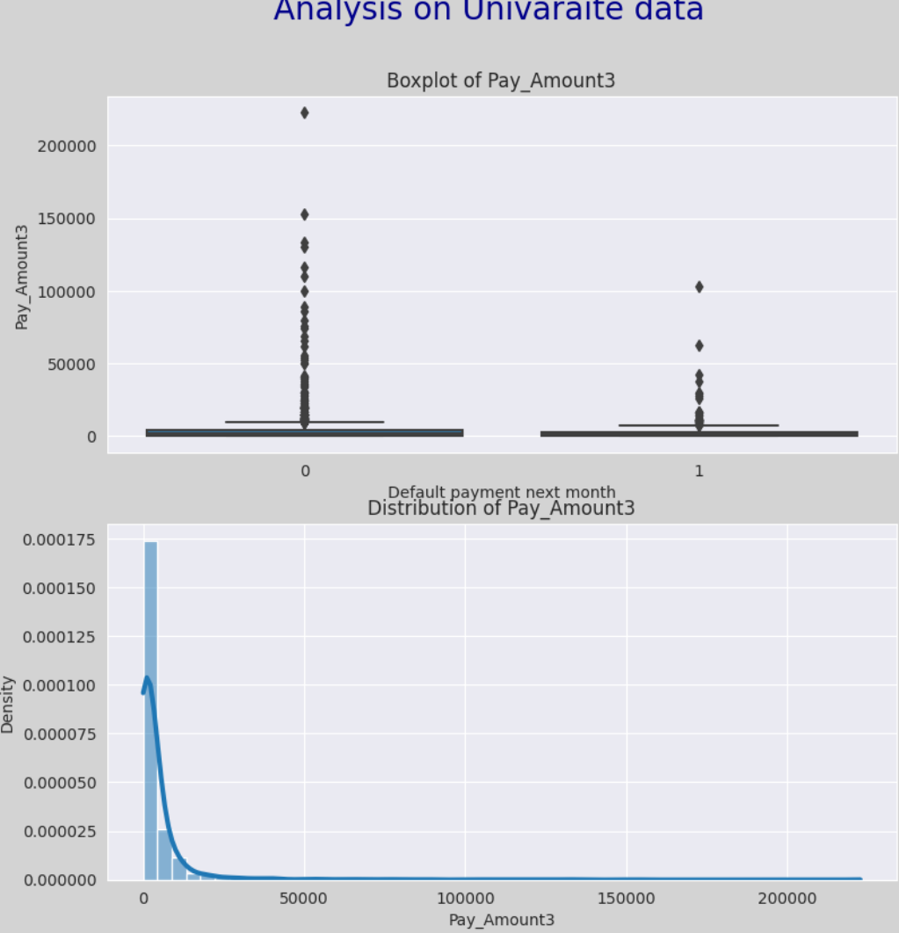
Analysis on numerical data
Pots on Pay Amount 1 to 3 month ago: Those who have default payment of 0 have a wider range and interquartile range as compared to those who have a default payment of 1. Both contains numerous outliers
From the histograms, Pay Amount 1 to 3 is positively skewed with majority less than around 3000

Slide 15
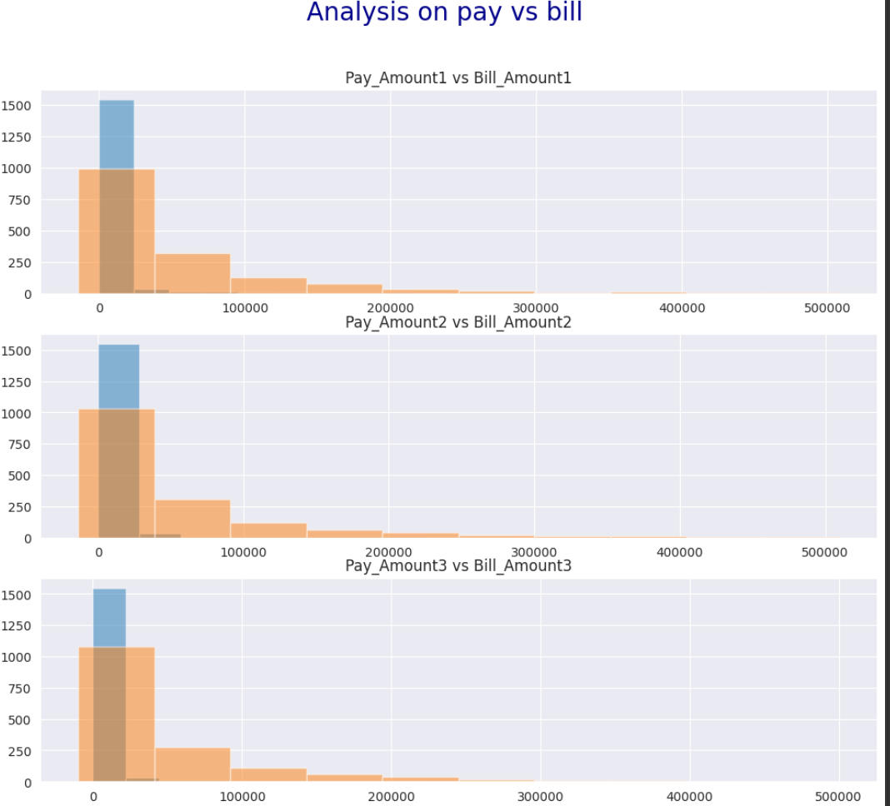
Analysis on pay vs bill
Pots on Pay Amount 1 to 3 month ago: Those who have default payment of 0 have a wider range and interquartile range as compared to those who have a default payment of 1. Both contains numerous outliers
From the histograms, Pay Amount 1 to 3 is positively skewed with majority less than around 3000

Slide 16
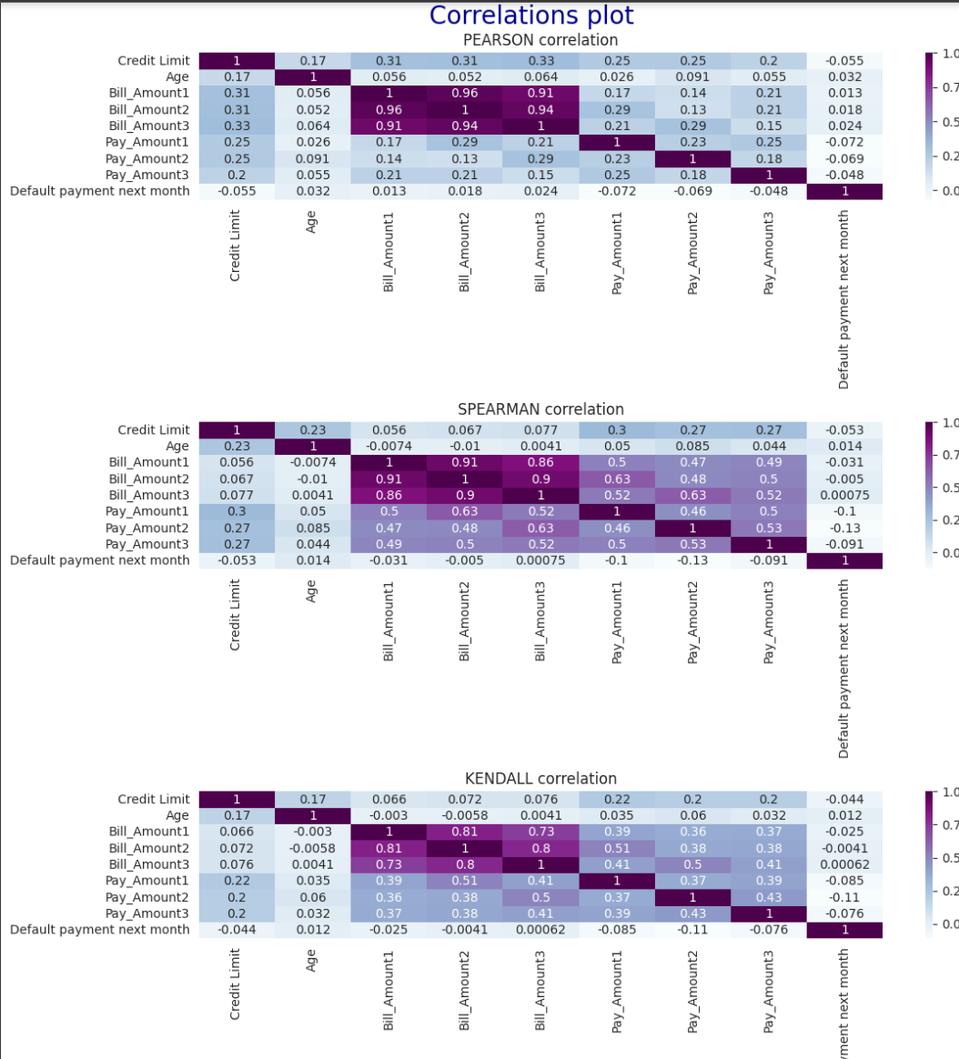
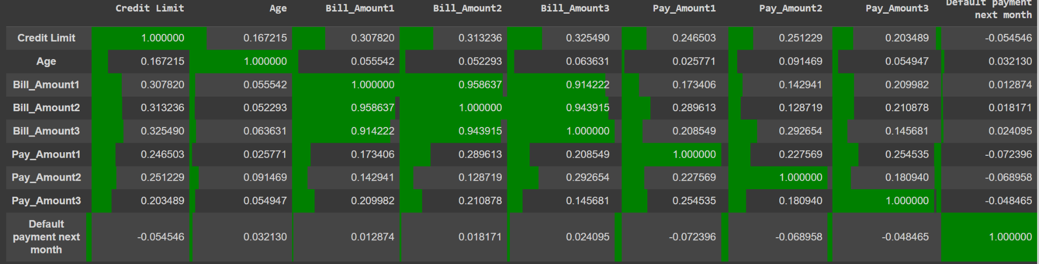
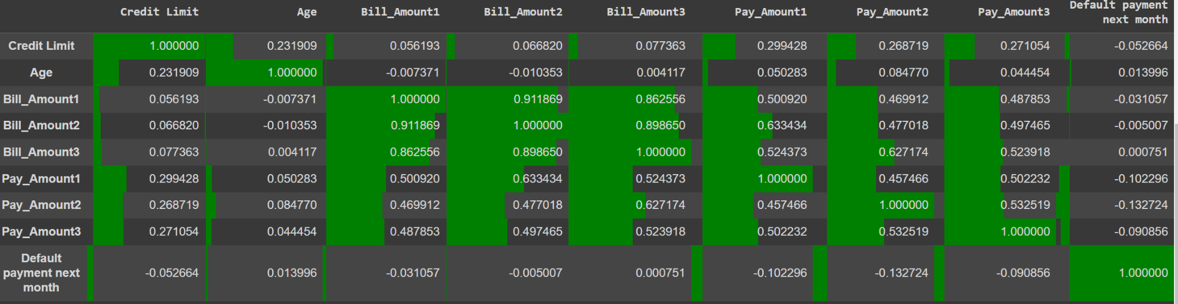
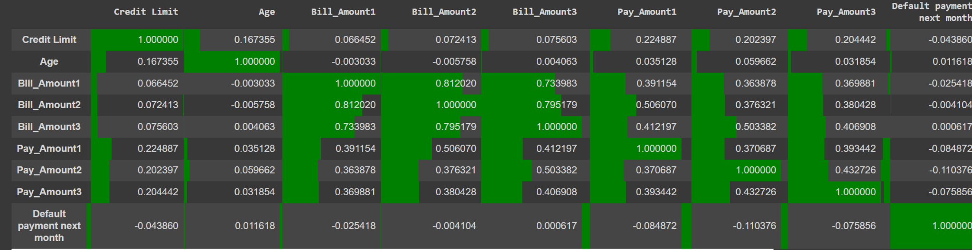
Correlation (Multicolinearity)
From the different types correlation plot, we observed that there is a strong relationship between bill amounts and pay amounts for different months
However, as bill amount 1 2 and 3 are variables that are dependent with each other, multicollinearity is not found

Slide 17
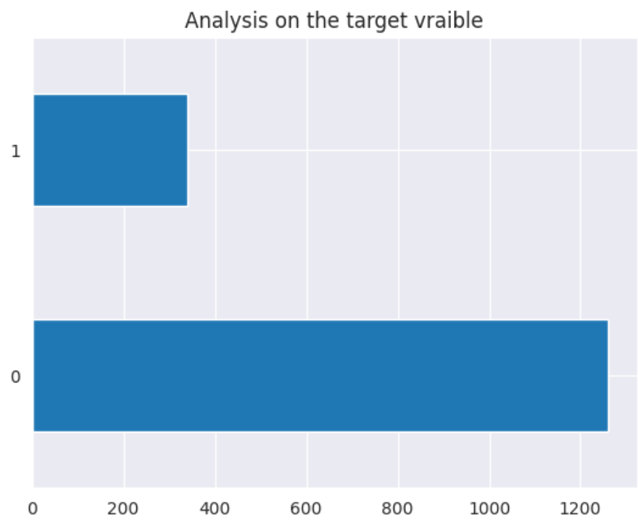
Analysis on target variable
Imbalance class was observed which could be a point of concern

Slide 18
02A
FEATURE
ENGINEERING
Here we will feature engineer the dataset

Slide 19
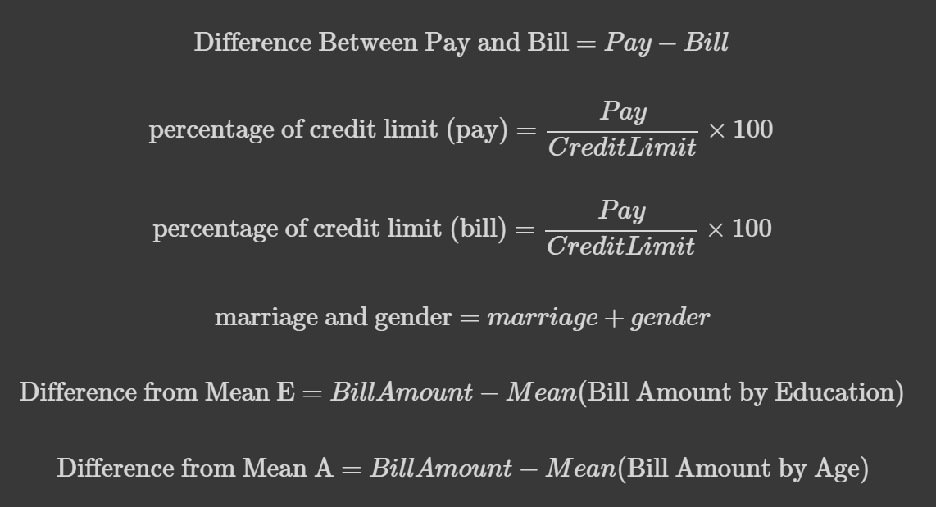
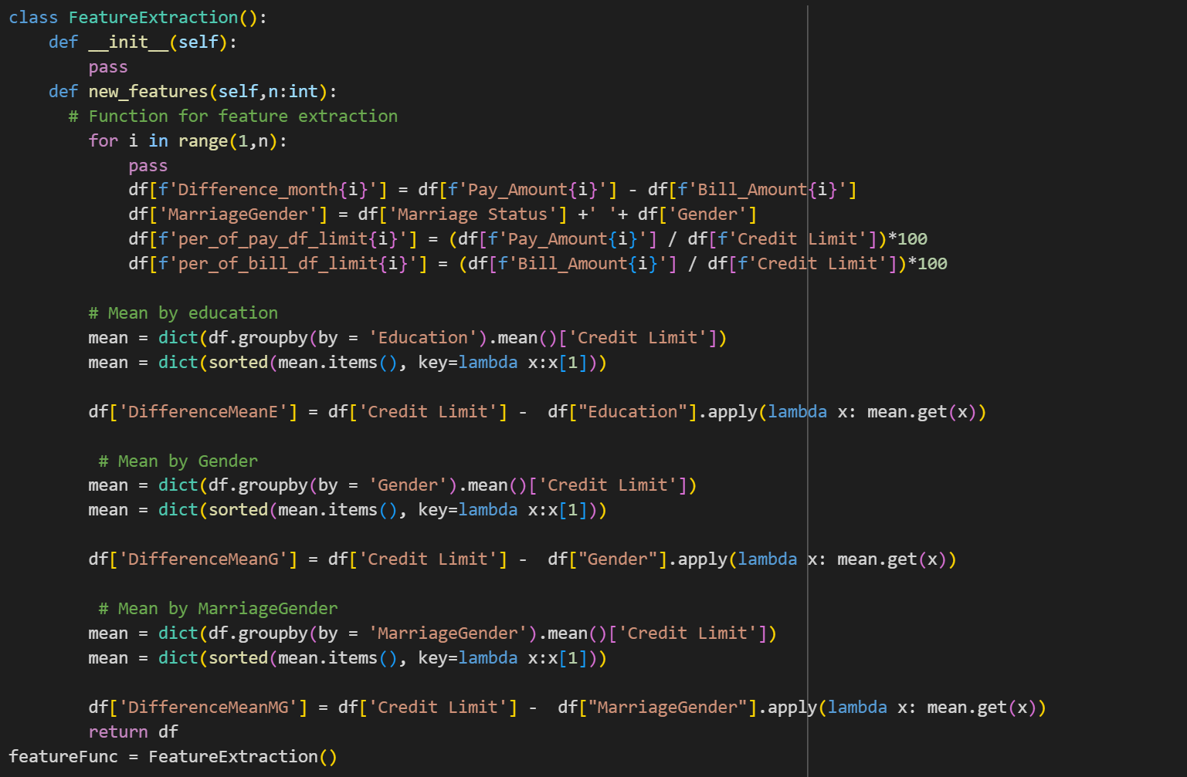
Feature Extraction
Function and Feature extracted columns

Slide 20
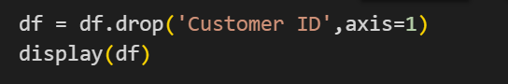
Feature and row SElection
Drop customer ID due to no meaning of column
Drop columns that have bill amounts 1,2,3 less than 0 and default payment 0 due to it having no exact definition

Slide 21
02B
DATA
PREPROCESSING
Data preprocessing of the dataset

Slide 22
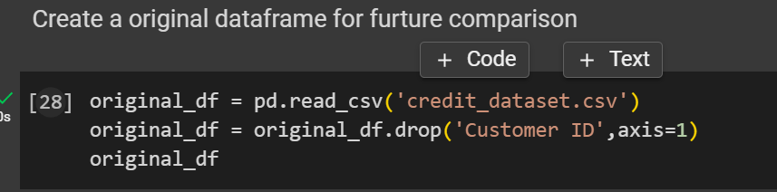
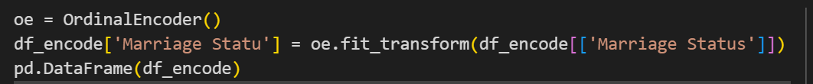
Data Processing (Preparing and encoding)
Original df was prepared for comparison in later parts
Data that are categorical was encoded
Marriage status , Gender was done with ordinal encoding
Marriage Gender was done with one hot encoding

Slide 23
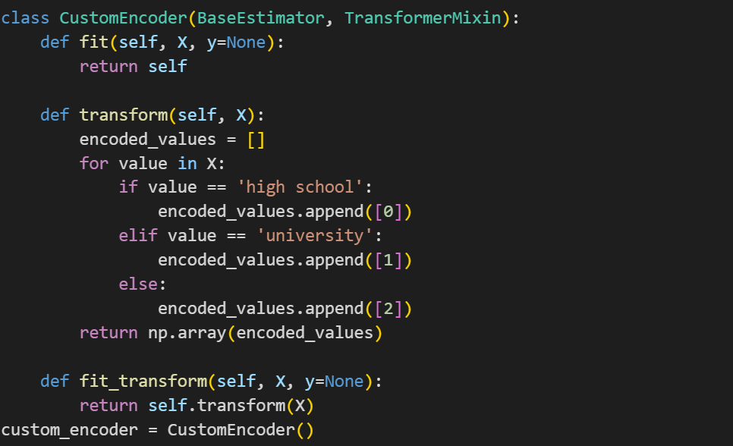
Data Processing (Preparing and encoding)
Education was done with custom encoding as on average different status have different state of incomes resulting in different influence

Slide 24
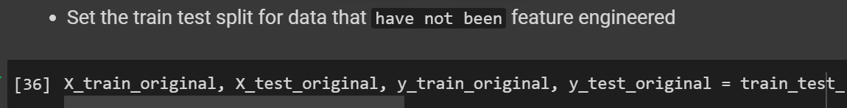
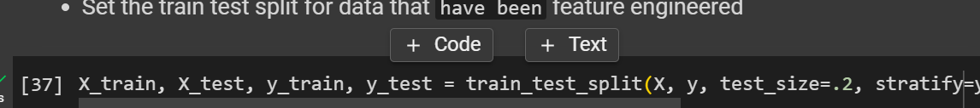
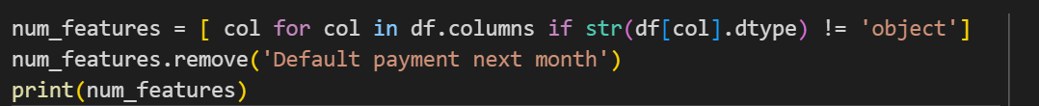
Create the train and test set for both the original and after dataframe
Train test split
Setting Numerical features

Slide 25
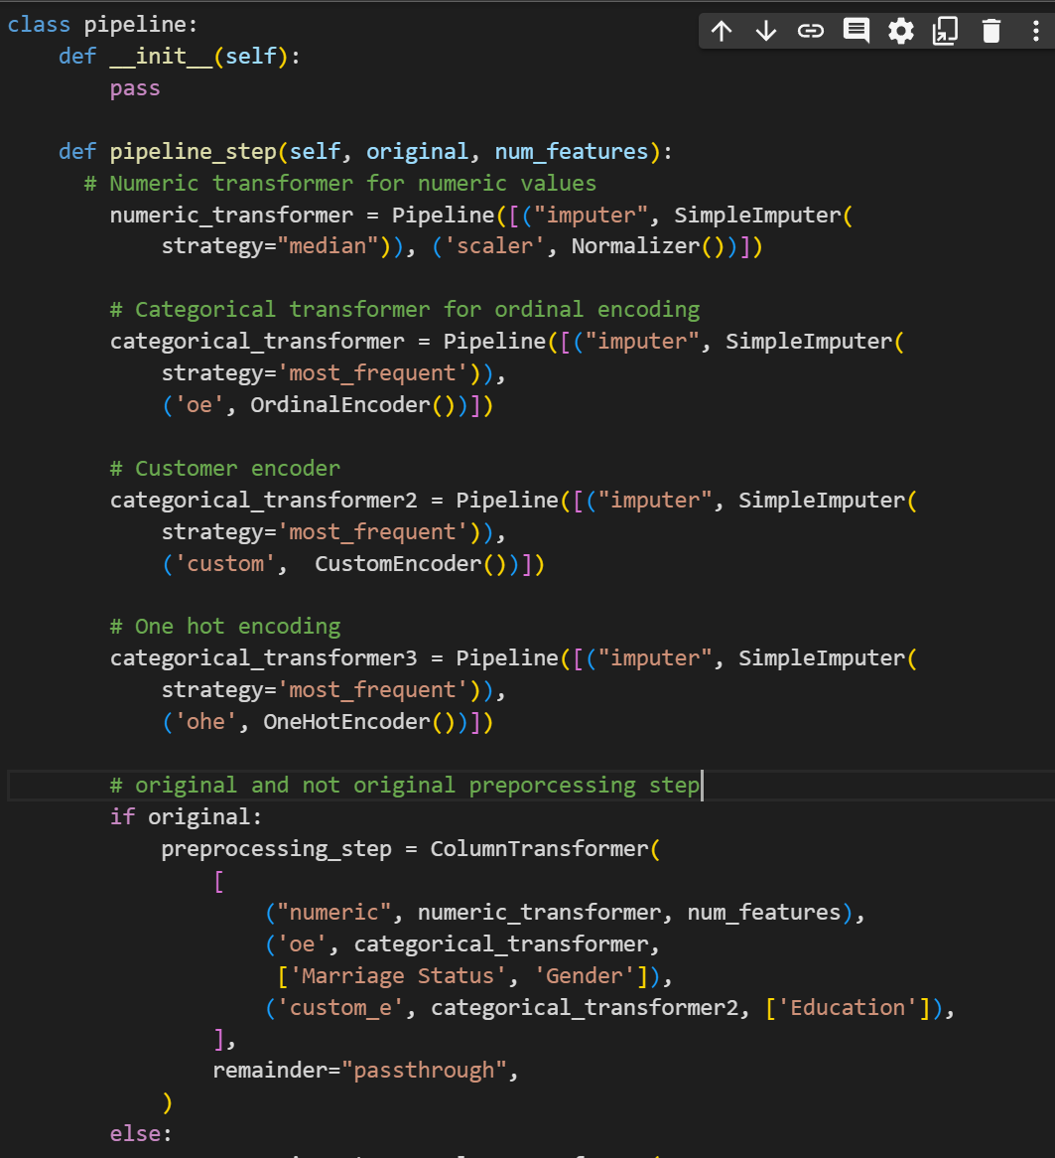
Setting the baseline pipeline (Blind scaling)
All the numerical values was done with Normalizer
Setting the values to between 0 and 1

Slide 26
Setting the model
LogisticRegressionClf
Simple model for classification that is easy to be interpret and performs well when relationship are close to linear
KNeighborsClf
Simplest of all algorithms which labels the new data point base on its closest neighbours
DecisionTreeClf
Subdivide the feature space into with mostly the same label
Can capture linear and non linear relationship in both numerical and categorical datas
ExtraTreesClf
Extra Trees is an ensemble method based on decision trees which reduces overfitting by using randomization during the tree-building process.
RandomForestClf
Ensemble method that combines multiple decision trees that reduces overfitting and provides better generalization performance and high-dimensional data and capture non-linear relationships
GradientBoostingClf,
Builds models sequentially, each correcting the mistakes of the previous model which can capture complex relationship
HistGBClf
Variantof gradient boosting that uses histograms to speed up training which can handle large datasets and provides efficient training and prediction.
AdaBoostClf
Ensemble method that combines multiple weak classifiers which focuses on difficult-to-classify examples, improving overall accuracy
SVC
versatile classifier for binary and multi-class classification tasks which can handle high-dimensional data and capture non-linear relationships using kernel tricks.
Neural Network'
highly flexible and can learn complex patterns and relationships

Slide 27
02C
MODEL
TESTING
Data preprocessing of the dataset

Slide 28
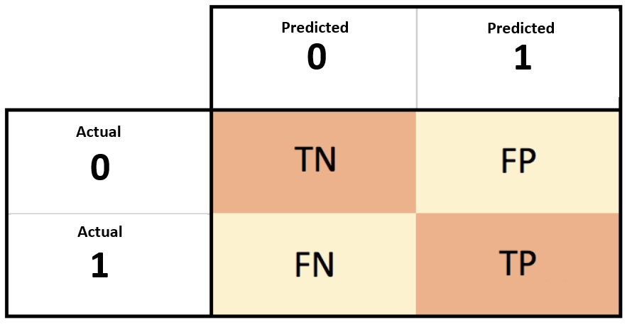
Evaluation metrics focused
Recall and Accuracy
Confusion matrix

Slide 29
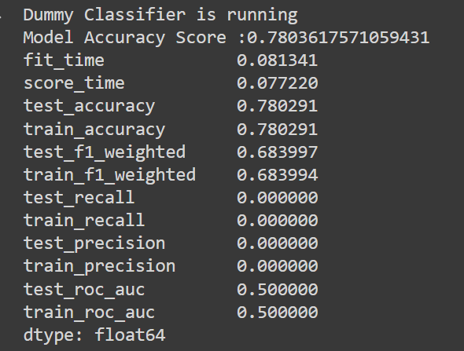
DUMMY BASELINE
The test accuracy is about 0.7 while the test recall is close to 0
Model is based on random guessing

Slide 30
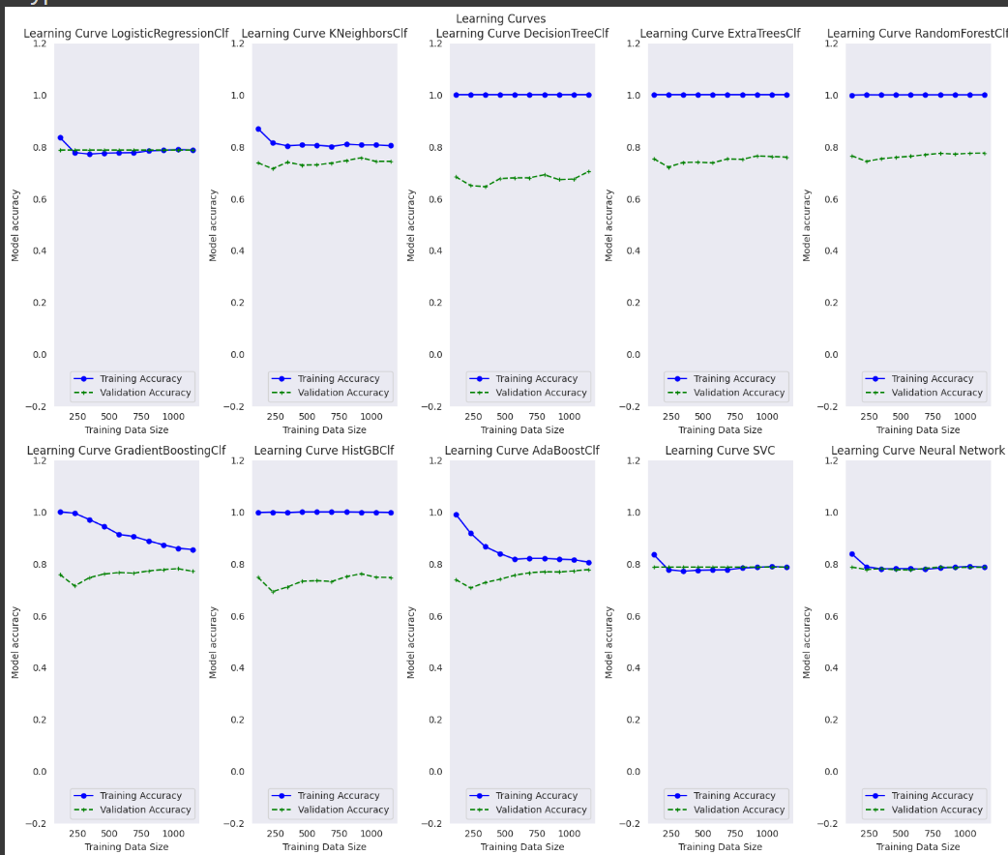
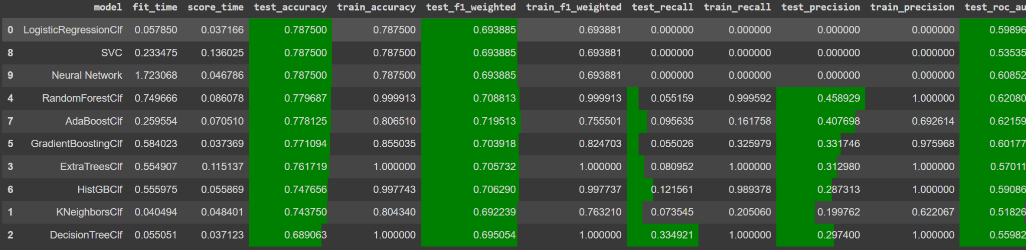
Results of the original dataframe
All the models did not experience any overfitting
Logistic regression, SVC, Neural Network has the tied highest test accuracy at 0.7875
Test recall for all models are less than 0.5 with the highest being 0.33

Slide 31
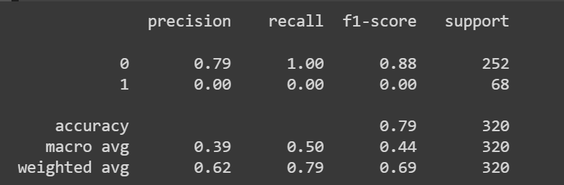
Additional analysis on logistic regression
Recall weighted average is 0.79
Precision weighted average is 0.62
F1 score is 0.69 for weighted average

Slide 32
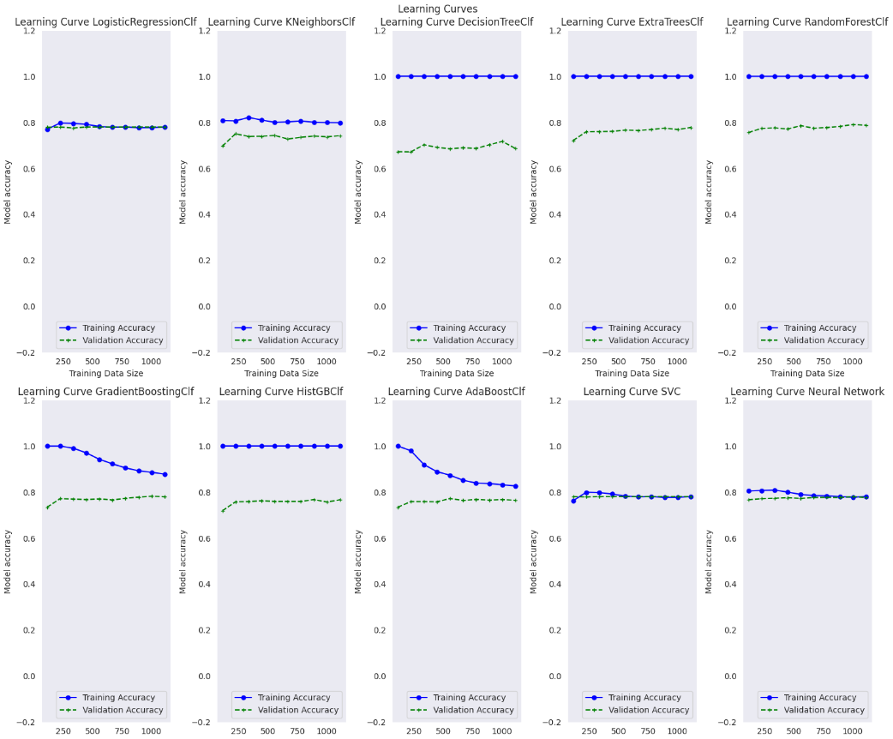
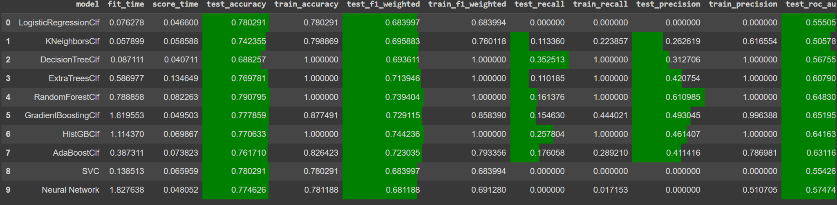
Results of the Featured Engineered dataframe (baseline)
All the models did not experience any overfitting
Random Forests has highest test accuracy at 0.791
Test recall for all models are less than 0.5 with the highest being 0.353

Slide 33
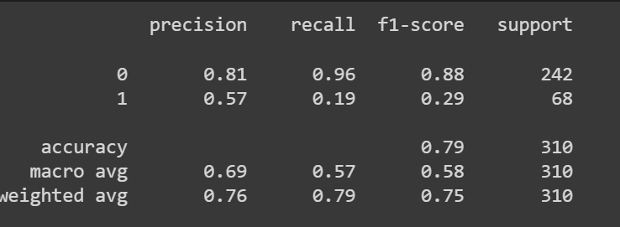
Additional analysis on random forest
Recall weighted average is 0.76 but with a higher macro average
Precision weighted average is 0.79
F1 score is 0.75 for weighted average

Slide 34
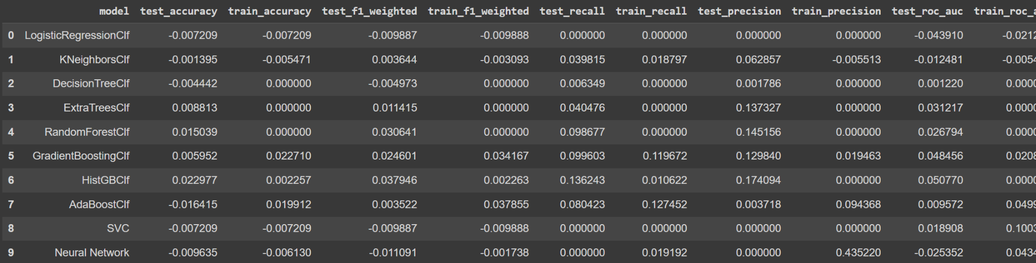
Compare the difference
Test Accuracy: About half of the model increase while the rest remain the same
Test recall increase for majority of the model

Slide 35
02D
ADVANCED MODEL
TESTING
Additional discretization was done and resamoke was used

Slide 36
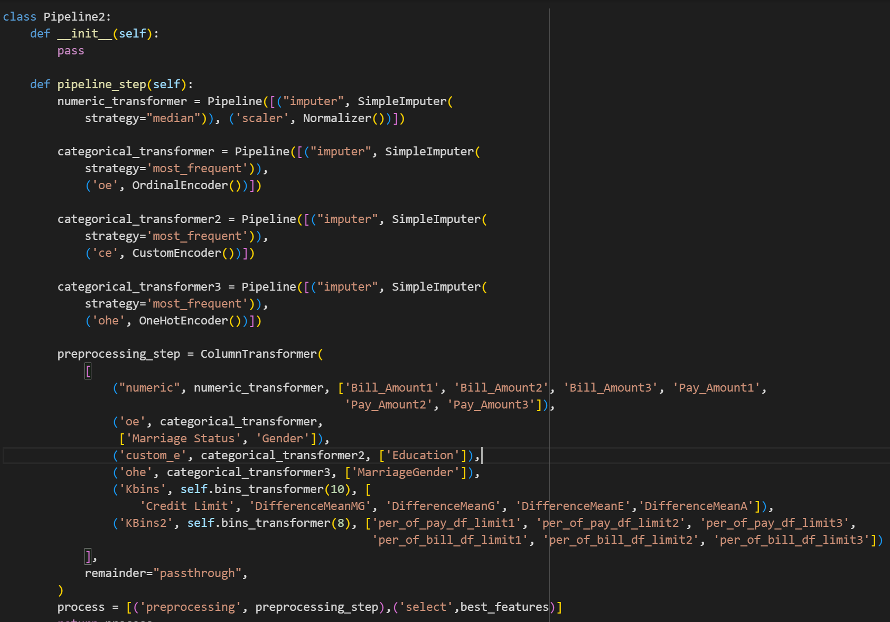
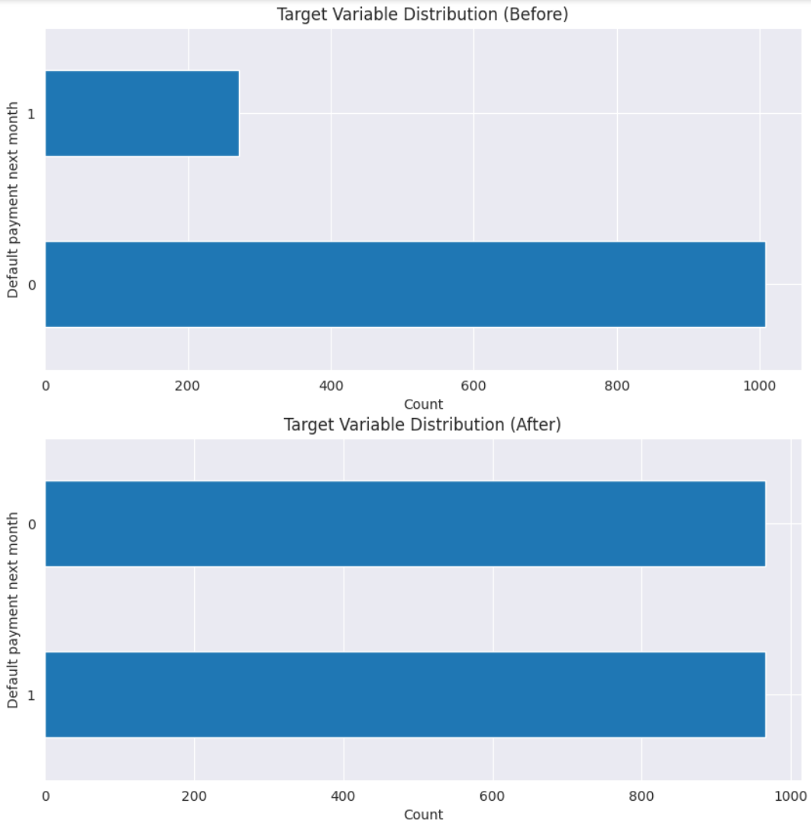
Observations
From the EDA portion, Age., Credit limit are example of column that can be used for discretization
Test size was also reduced to 0.15
Kbins discretization was also selected
Additional feature selection was done with selectkbest
In addition, class imbalance was also observed (SMOTEN was used )
Below shows the new pipeline

Slide 37
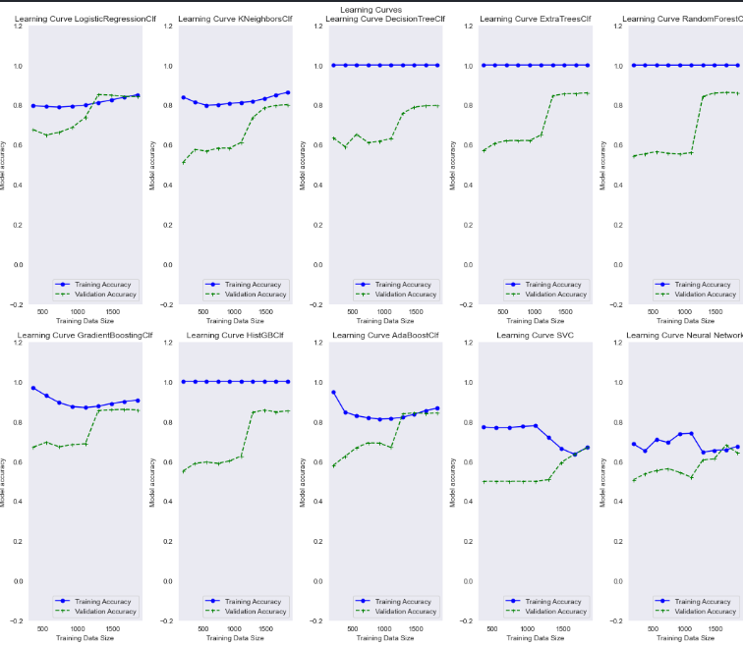
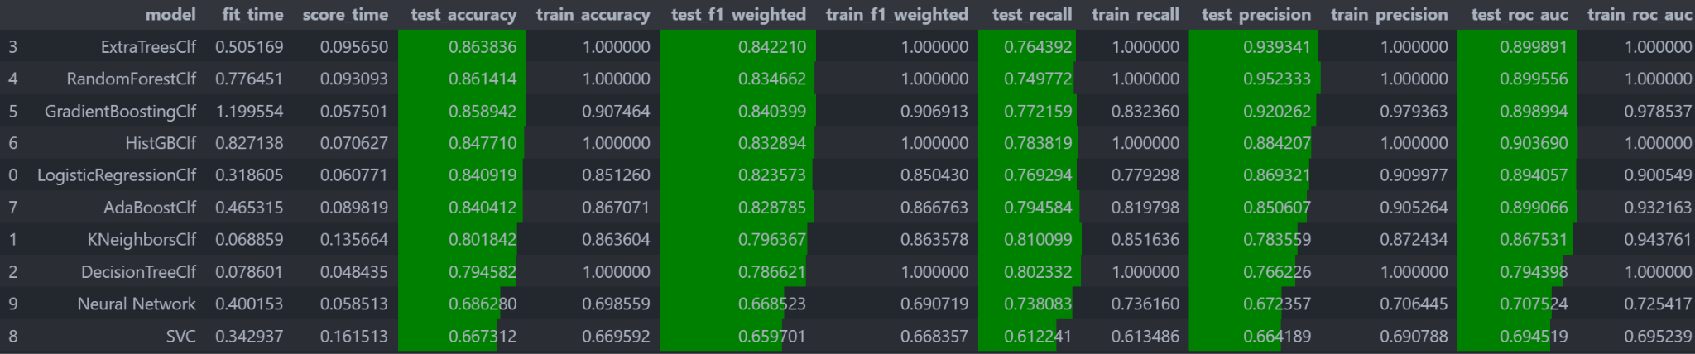
Results of the Featured Engineered dataframe (Advanced)
All model did not show signs of overfitting
Extra Tree has the highest test accuracy at 0.863
All models scored above 0.8 except for neural network and SVC
Test Recall also improved where all models are above 0.7 except for SVC
Across the board, all models improved

Slide 38
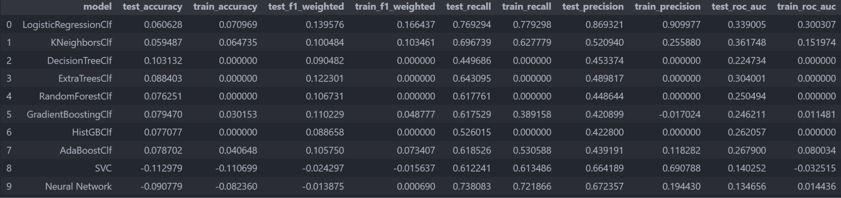
Compare the difference
All test accuracy experience an increase after resampling and bins discretization
This is also seen in recall
Across other evaluation metrics, all scores improved which shows the usefulness of resampling

Slide 39
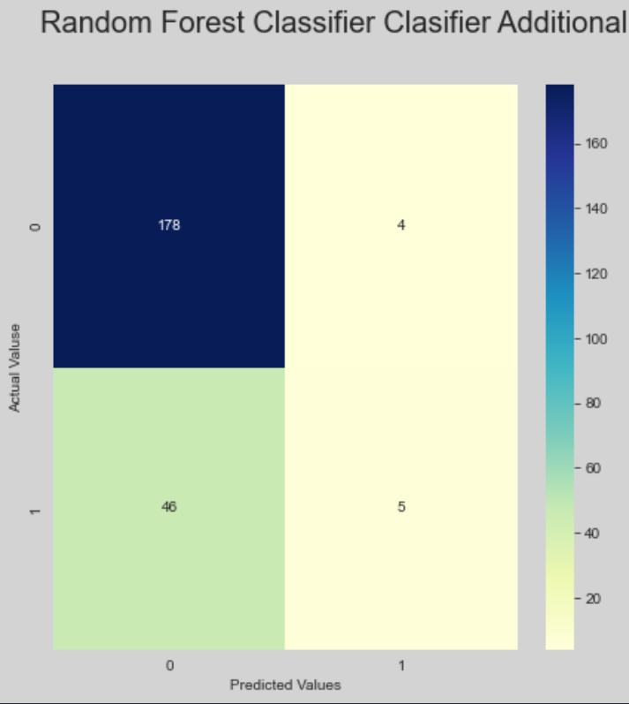

Additional analysis on top 3 models (Random Forest)
Recall score of 0.79 , F1 score 0.74 and precision 0.75 in terms of weighted average
Confusion matrix shows that the model has a pretty high false negative

Slide 40


Additional analysis on top 3 models (EXTRA TREE CLASSIFIER)
Recall score of 0.77, F1 score 0.77 and precision 0.70 in terms of weighted average
Confusion matrix shows that the model has a pretty high false negative

Slide 41


Additional analysis on top 3 models (Gradient Boosting)
Recall score of 0.78 , F1 score 0.78 and precision 0.73 in terms of weighted average
Confusion matrix shows that the model has a pretty high false negative but it is better than the first two models

Slide 42
03
HYPERPARAMETER
TUNING
Hyperparameter tune (Lasso, Ridge, Gradient Boosting)

Slide 43

RANDOM FOREST (Hypertune)
Randomised CV was used due to the quicker runtime and ability to run a higher fold in a same period of time

Slide 44





Random forest (Hypertune)
No overfitting seen
Accuracy score improved
Compare to a dummy model, we can see that Logistic regression improved in all areas
Classification report accuracy scores improved

Slide 45





EXTRA TREE (Hypertune)
No overfitting seen
Accuracy score improved
Compare to a dummy model, we can see that Logistic regression improved in all areas
Classification report accuracy scores improved

Slide 46




Gradient boosting (Hypertune)
No overfitting seen
Confusion matrix false negative improved from 47 to 46 with hypertuned
Compare to a dummy model, we can see that Extra Trees improved in all areas

Slide 47

AUC Curve
Here we can see that Extra tree and random forest has the highest auc of 0.68 while gradient boosting has the lowest

Slide 48
04
STACKING
CLASSIFIER
Hyperparameter tune (Lasso, Ridge, Gradient Boosting)

Slide 49




Stacking classifier
Stacking Classifier indeed improve the scores of the model
However auc is lower compared to extra tree and Random Forest alone

Slide 50
05
FINAL
MODEL
Hyperparameter tune (Lasso, Ridge, Gradient Boosting)

Slide 51

FINAL MODEL
Random Forest Classifier was chosen
Test accuracy of 0.86 with test recall of 0.76
Classification report of precision is 0.78 and recall is 0.79s

Slide 52



Final model vs dummy model
False negative was reduced by some margin and test accuracy increase with other evaluation metrics also increased through the process

Slide 53

THings to improved for the model and how did the model interpret
This system tends to make mistake in predicting positive class but this could be due to the dataset being imbalance and too small and that even when resample, the data is still too small to make an accurate prediction

Slide 54
06
FEATURE
IMPORTANCE
Permutation importance was used here

Slide 55

Feature importance
From the above feature importance, we can see that the best feature was actually difference between mean between gender, which could possibly means that if there is a huge difference between the average, then there could be a higher risk of defaulting

Slide 56
Summary
Overall the model improved as compared to a baseline model, while stacking classifier was great the score produced for auc is not ideal, hence I reverted to Random Forest for a more balanced score across the board

